Slide 1
NOISE POLLUTION MONITORING SYSTEM
SUBMITTED BY
VIDHYASAGAR.K
SASIKANNAN.S
NAVEEN KUMAR.S
ARUN.C

Slide 2
COMPONENTS
INTRODUCTION
RELATED WORK
METHODOLOGY
BLOCK DIAGRAM
SYSTEM DESIGN
SYSTEM SPECIFICATION
PROGRAM
RESULT
CONCLUSION

Slide 3
INTRODUCTION
Noise pollution could be a growing issue of late. it's necessary to watch the air and noise pollution levels to make sure a healthy and safe atmosphere.
With the fast increase in infrastructure and industrial plants, environmental problems have greatly influenced the requirement of sensible observation systems.
Thanks to its low price, high potency and flexibility, web of Things (IOT) has become extremely popular currently of late.
web of Things (IOT) permits interaction between devices and humans. It forms a communication medium from human to machine.3

Slide 4
Previously, knowledge collectors had to travel long distances to the assorted locations to gather knowledge when that the analysis was done. This was drawn-out and time intense.
But now, sensors and microcontrollers connected to the web will create environmental parameter observation additional versatile, correct and fewer time intense.
once the atmosphere Merges with sensors and devices to self -protect and self -monitor it forms a sensible atmosphere. Embedded intelligence makes the atmosphere act with the objects. during this model, we tend to square measure employing a Raspberry Pi 3B microcontroller, which can have gas sensors and noise sensors connected to that, to watch the unsteady environmental parameters.

Slide 5
RELATED WORK
There are numerous works that have been done related to IOT based air and sound pollution monitoring Projects.
Varun Jain,Mansi Goel, Mukulika Maity, Vinayak Naik, Ramachandran Ramjee propose a framework to estimate air pollution for a given locality by using maximum advantages of the existing infrastructure of monitoring stations.
Unfortunately, India still lacks the infrastructure required to measure pollution at a granular scale.
Archit Aggarwal,TanupriyaChoudhary, Praveen Kumar Proposes a fuzzy interface system for the calculation of AQI using two pollutants with each having six linguistic variables.

Slide 6
The traditional method used is linear interpolation where only one pollutant is considered to calculate AQI.
Somansh Kumar, Ashish Jasuja present work, the air quality Data from New Delhi, Mumbai, Chennai and Bengaluru has been used. Initially, dimension reduction has been performed on the data. After that, the data has been deseasonalized.
Arnab Kumar Saha1, Sachet Sircar2, Priyasha Chatterjee3 Proposed that in today's world, the continuous rise in air and sound pollution has become a serious problem. Controlling and carefully monitoring the situation has become necessary in order to take the necessary steps to alleviate the situation.
This research has proposed an IOT-based technique for monitoring the air quality index and noise intensity of a region.

Slide 7
Noise pollution is becoming a more significant concern, resulting in a slew of environmental issues such as the fog-haze weather phenomenon,which can be hazardous to human health.
The design and manufacturing of a portable sensory system for air pollution monitoring that can detect temperature, humidity, and particle matter is the topic of this research(PM).
It detecting impurities using gas sensor. The sensor is connected to the Arduino which consist of code which will help us in detecting the amount of impurities in the air.
Baihaqi Siregar says wireless sensor network(WSN) utilizing wasp mote smart cities device, connected with several sensors, such as dust sensor PM-10 (GPY21010AU0F),humidity sensor(808H5V5), luminosity sensor(LDR),and microphone(DBA).

Slide 8
METHODOLOGY
The project is geared toward developing a system capable of Monitoring pollutants within the air and noise within the sound.
The projected System was developed exploitation Raspberry pi, sound device, Gas device and temperature device. This air quality and sound quality detection and observance System provides real time information which might be accessed from Computers and mobile devices.
The diagram of the projected system is illustrated in Figure one.

Slide 9
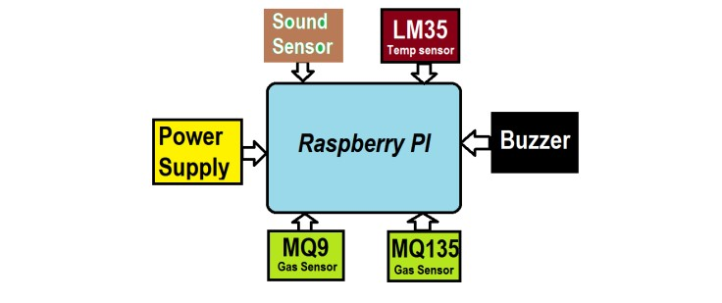
BLOCK DIAGRAM

Slide 10
SYSTEM DESIGN
The MQ135 and MQ9 Gas sensing element was accustomed collect pollution. And sound sensing element and temperature sensing element (LM35) accustomed collect sound intensity and temperature severally.
The information is transmitted via LAN module that is gift in raspberry pi mistreatment the web to the cloud servers, this info may be retrieved via sensible phone or internet enabled devices.
The transmission and retrieving of information happens in close to real time.
The information of the parameters being measured area unit displayed on a 16*2 alphanumeric display screen.

Slide 11
AN alarm would sound within the event once the pollution and pollution is detected And information is send to cloud storage which is easily available for anyone.
Also it draw the graph on thing speak site for analysis the data for government authority.
SYSTEM SPECIFICATION
1. Raspberry PI
2. MQ9 Sensor
3. Temp Sensor
4. Sound Sensor
5. MQ135 Sensor
6. Buzzer

Slide 12
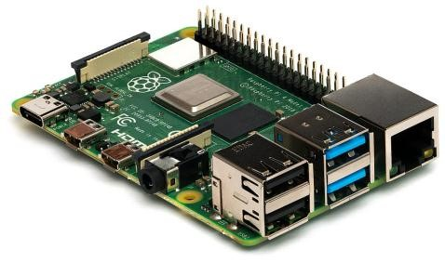
1.RASPBERRY PI
The Raspberry Pi may be a low cost, credit-card sized pc that plugs into a pc monitor or TV, and uses a customary keyboard and mouse. it's a capable very little device that permits individuals of all ages to explore computing, and to be told the way to program in languages like Scratch and Python.

Slide 13
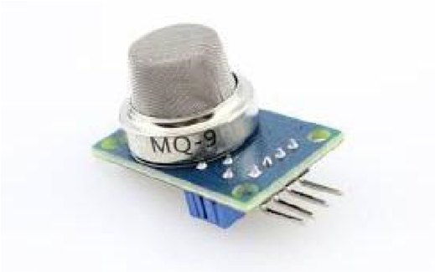
2. MQ9 SENSOR
This MQ-9 CO gas, Methane, and LPG Gas sensor Module are accustomed sense CO gas and aliphatic compound Gas. SnO2 is the sensitive material of the gas sensor MQ9, that has lower physical phenomenon in clean air. It makes detection by the maneuver of cycle high and cold, and sight CO once the cold (heated by one.5V). The sensor’s physical phenomenon is higher at the facet of the gas concentration rising.

Slide 14
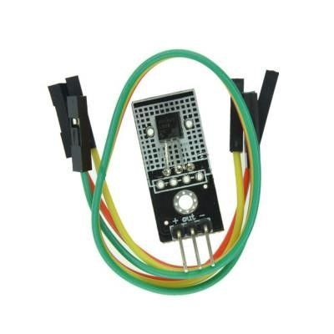
3.TEMP SENSOR
A temperature detector may be a device accustomed live temperature. this may be air temperature, liquid temperature or the temperature of solid matter. There are differing types of temperature sensors offered and them every use totally different technologies and principles to require the temperature activity. Temperature sensors accustomed measure temperature in many alternative applications and industries.

Slide 15
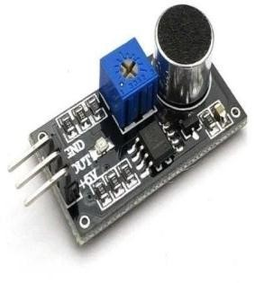
4.SOUND SENSOR
A sound sensor is defined as a module that detects sound waves through its intensity and converts them to electrical signals.
Sound detection sensor works similarly to our Ears, having a diaphragm which con-verts vibration into signals.

Slide 16
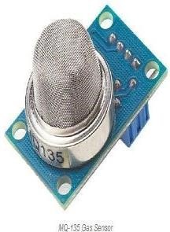
5.MQ135 SENSOR
The MQ series of gas devices utilize a touch heater inside with associate natural science detector. These sensors square measure sensitive to a spread of gases used at temperature. MQ135 alcohol device is also a Sno2 with a lower natural phenomenon of contemporary air.

Slide 17
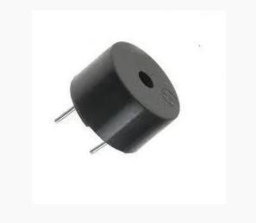
6.BUZZER
The buzzer could be a sounding device that may convert audio signals into sound signals. it's sometimes power driven by DC voltage.
it's wide utilized in alarms, computers, printers and alternative electronic merchandise as sound devices.

Slide 18
PROGRAM
import sounddevice as sd
import numpy as np
import time
import requests
# Replace with your server URL
server_url = "https://your-server.com/api/noise"
# Parameters for audio recording
sample_rate = 44100 # Samples per second
duration = 10 # Duration of each recording in seconds threshold = 0.05 # Adjust this value as needed
def record_audio():
print("Recording audio...")
audio_data = sd.rec(int(duration * sample_rate), samplerate=sample_rate, channels=2, dtype='int16') sd.wait()
return audio_data

Slide 19
def calculate_noise_level(audio_data):
rms = np.sqrt(np.mean(audio_data**2))
return rms
def send_data_to_server(noise_level):
data = {"noise_level": noise_level}
try:
response = requests.post(server_url, json=data)
if response.status_code == 200:
print("Data sent to the server successfully.“)
else:
print("Failed to send data to the server.“)
except requests.exceptions.RequestException as e:
print(f"Error: {e}“)

Slide 20
while True:
audio_data = record_audio()
noise_level = calculate_noise_level(audio_data)
print(f"Noise Level: {noise_level}“)
if noise_level > threshold:
print("Noise level exceeded threshold. Sending data to the server...“) send_data_to_server(noise_level)
time.sleep(30) # Adjust the sleep time as needed

Slide 21
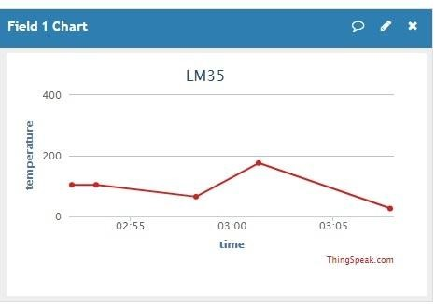
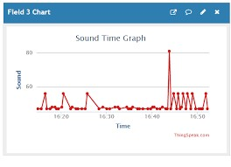
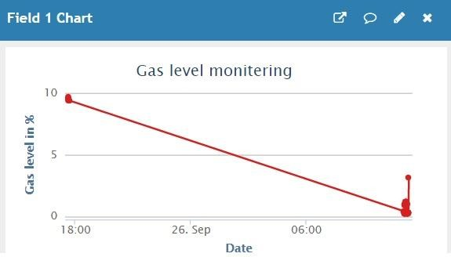
RESULT
The detected air pollution, sound pollution and temperature are displayed below in Fig.8

Slide 22
CONCLUSION
The smart because of monitor setting and a cheap, low price embedded system is given with fully completely different models throughout this paper. at intervals the projected style functions of assorted modules were mentioned.
The noise and pollution observation system with internet of Things (IOT)concept through an experiment tested for observation 2 parameters. It additionally sent the device parameters values to the cloud.
This information are going to be useful for future analysis and it will be simply shared to alternative finish users.
This model will be additional swollen to watch the developing cities and industrial zones for pollution observation.

Slide 23
THANK
YOU

